Slide 1

Customer Churn prediction for Telecommunication Industry
Technical Presentation on Science and Technology
Advancement-Assessment & Review
NAME – SAMBIT PRUSTY
REGD. NO. - 20010401
Guided By: Prof. Manas Ranjan Mishra

Slide 2
CONTENT
Introduction​
Literature Review
Patent Search
Technical details​ of the paper
Performance analysis
Proposed Model
Summary
References

Slide 3
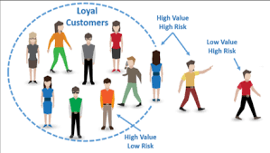

INTRODUCTION
CUSTOMER CHURN PREDICTION IN TELECOM SECTOR
Customer churn refers to customers discontinuing business with a company, and in the telecom sector, it can result in lost revenue, increased costs, and reduced profitability, prompting companies to predict churn and take proactive measures to prevent it.
Churn prediction is critical for telecom companies because retaining existing customers is much more cost-effective than acquiring new ones.
Churn prediction models are typically built using customer data such as usage patterns, demographics, and historical behavior.
Effective churn prediction can help telecom companies reduce customer turnover rates, increase customer satisfaction, and ultimately improve their bottom line.

Slide 4
LITERATURE REVIEW
Author (Year) | Title | Methodology | Advantage | Disadvantage | Proposed Enhancement
Ullah et al. (2019) | Customer churn identification in telecom sector | Random Forest(RF), cosine similarity, and k-means clustering. | As RF gives 88.63% classified instance | The scheme is not robust for higher prediction. | Deep learning model’s multi layering can be benefited here.
Idris and Khan (2016) | CP system for telecommunication | Ensemble classifier, Genetic algorithm, Support Vector | Best performance in churn forecast is achieved. | Performance degradation is found towards unstructured data. | Data classification, Normalized dataset
Wu et al. (2021) | Management of customer churn | Bayesian Logistic Regression, K-means clustering, Retention strategies | Better accuracy, F1–score, precision | It consumes almost equivalent processing time for larger as well as small datasets. | Deep learning model’s multi layer processing can be benefited here.

Slide 5
LITERATURE REVIEW
Author (Year) | Title | Methodology | Advantage | Disadvantage | Proposed Enhancement
Ahmed and Maheswari (2017) | Churn prediction on huge telecom data using hybrid firefly based classification | Firefly & Hybrid Firefly | The hybrid firefly algorithm exhibits slightly higher accuracy of 86.38% when compared to the firefly algorithm (86.36%) | Scheme ineffectively manages the higher dimension data. | Incorporation of schemes or modifications to reduce False Positive rates
Amin, Shah et al. (2017) | Customer churn prediction in telecom sector | CRM , SVM classifier | It gives higher accuracy along with precision. | Time consuming. | SMOTE can be used to perform the data handling more accurately in less time.
Amin, et al. (2019) | Development in CCP model | NB classification and General algorithm | Model gives experiential outcomes with higher accuracy and precision. | Zero frequency issue. | Data pre-processing, customer segmentation can be developed.

Slide 6
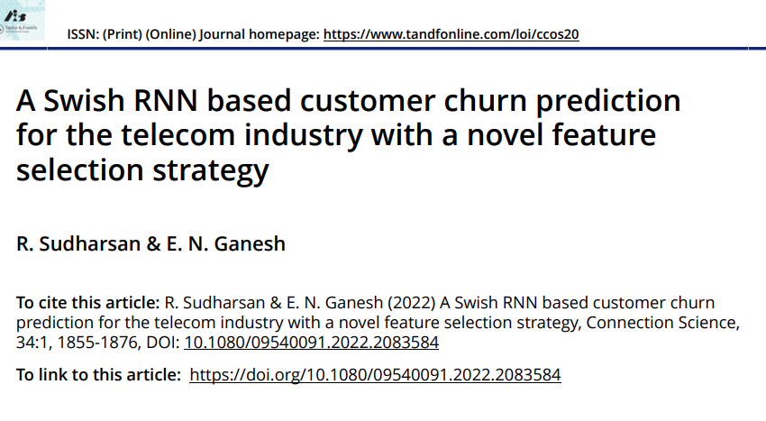
PATENT SEARCH

Slide 7
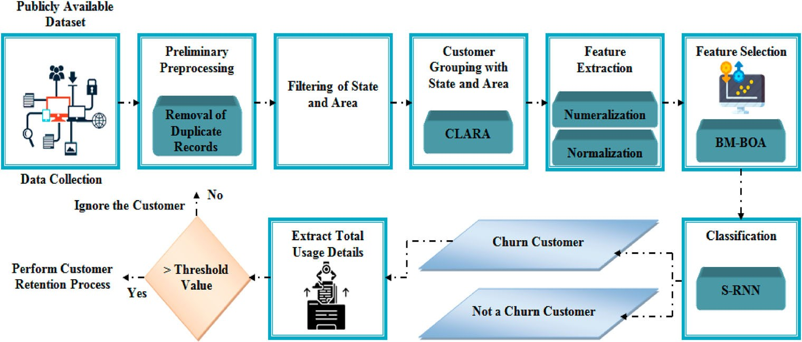
Technical Details of Studied paper
1. CLARA ALGORITHM –
Grouping customer records based on unique attributes, which is a challenging task for telecom companies with diverse customer information. To address this issue, the Clustering Large Applications (CLARA) algorithm is used as an extension of the Partitioning Around Medoids (PAM) clustering technique, which is more suitable for larger datasets and reduces computation time and memory allocation issues.

Slide 8
2. BM-BOA ALGORITHM -
In churn prediction, the Feature Selection (FS) phase is essential to select the most useful features and remove noisy ones, leading to improved model performance. To address this, the BM-BOA algorithm is developed by combining the traditional Butterfly Optimization Algorithm (BOA) with Brownian Movement (BM) to enhance the randomization phase and avoid local optima. BM-BOA is effective in solving intricate multi-modal functions with manifold local minimums and improving the performance of churn prediction models.
3. S-RNN ALGORITHM -
It is same as any other RNN ,but the major point that makes it differ from other is its swish activation function.
The swish AF overcomes the major drawback vanishing gradient. Thus, to attain better classification outcomes, this function is incorporated in RNN.
Next, the chosen features are given as input to the Swish – Recurrent Neural Networks (S-RNN) algorithm.
CC and non-CC are the “2” form of last outcome as of the S-RNN classifier.
Churn customer: The customer who is willing to move on to another telecommunication network.
Non-churn customer: The customer who was ready to sustain on the same telecommunication network.

Slide 9
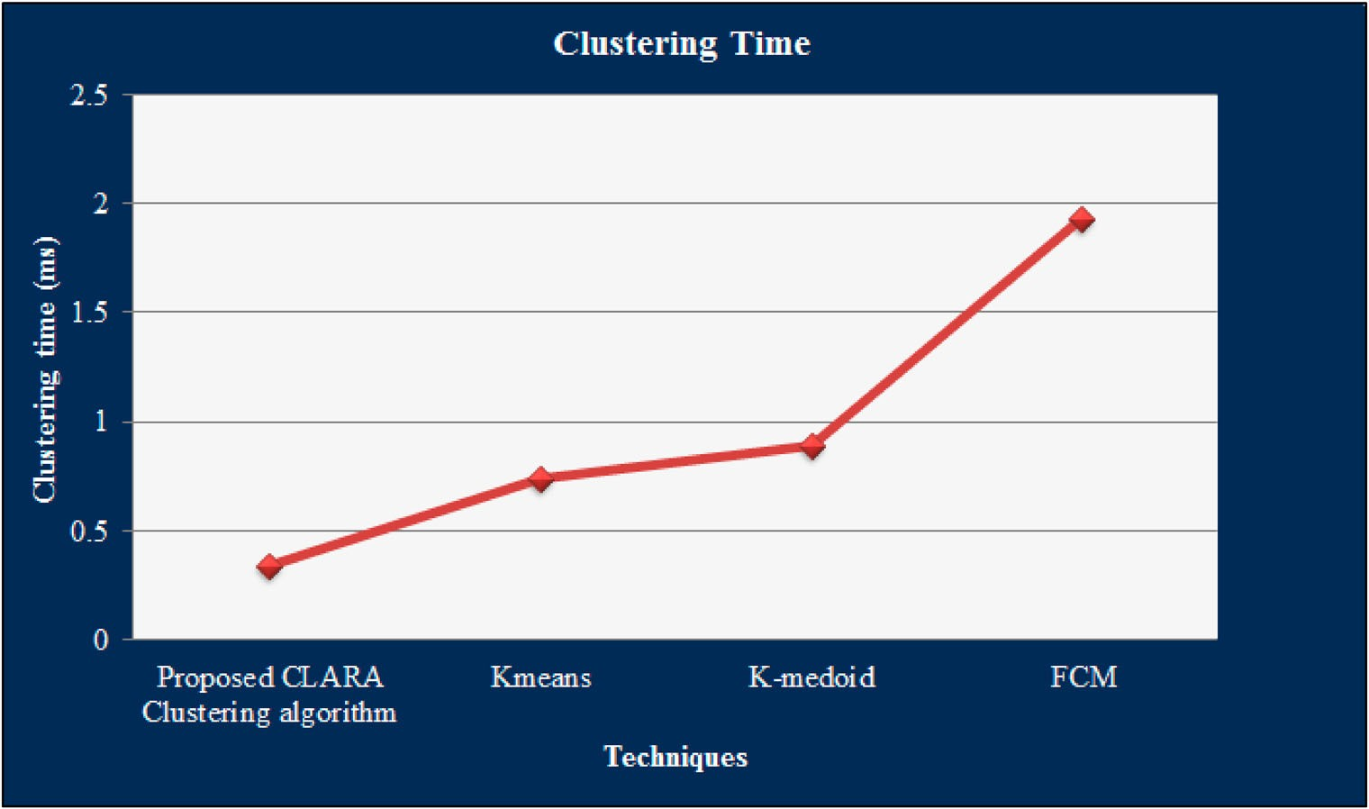
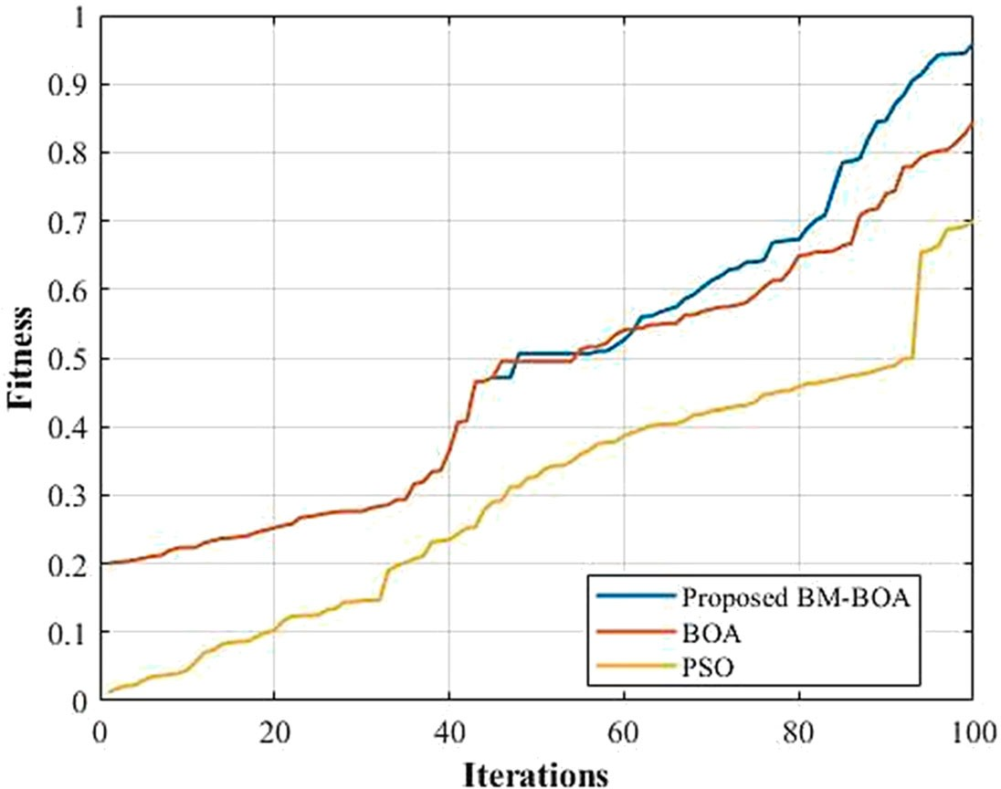
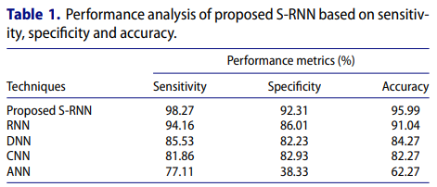
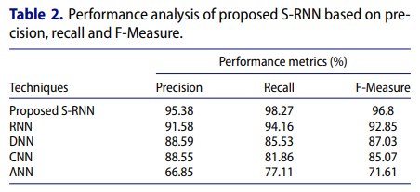
PERFORMANCE ANALYSIS

Slide 10
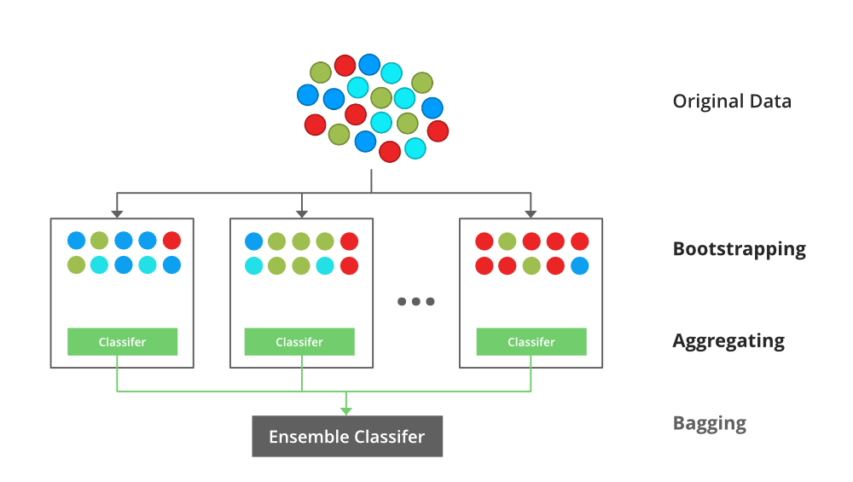
PROPOSED METHODOLOGY
XG-Boost :
XG-Boost (Extreme Gradient Boosting) is a popular machine learning
algorithm used in various applications, including telecom churn
prediction. It is a gradient boosting algorithm that builds a strong
predictive model by combining multiple weak predictive models.
In telecom churn prediction, XG-Boost can be used to identify the most
important features related to customer churn, as well as to predict
which customers are likely to churn. The algorithm can handle both
numerical and categorical data, and can handle missing data by using
its built-in techniques for imputing missing values.
To use XG-Boost in telecom churn prediction, first, the dataset needs to be preprocessed, including data cleaning, feature engineering, and feature selection. Next, the data can be split into training and testing datasets. XG-Boost can then be trained on the training dataset to build a predictive model, and the model can be tested on the testing dataset to evaluate its performance.
One advantage of XG-Boost is that it can handle imbalanced datasets, which are common in telecom churn prediction, where the number of churners is typically much smaller than the number of non-churners. XG-Boost can also handle large datasets and can be parallelized for faster training.

Slide 11
SUMMARY
Swish RNN based customer CP is proposed for the telecommunication industry with a novel FS strategy. Data collection, preliminary preprocessing, filtering of state and area, grouping customers with state and area, FE, FS, classification, CP and retention process are the steps of the proposed approach.
Next, the experimentation analysis is employed. In order to corroborate the proposed algorithm’s effectiveness, the performance analysis together with the comparative analysis of the proposed and prevailing techniques is done concerning some performance metrics. Disparate uncertainties can be handled by the developed approach, and it exactly envisages whether the customer will churn or not. The CP dataset, which is a publicly available dataset, is employed for the analysis.
The highest metrics rate, say, 98.27% sensitivity, 92.31% specificity and 95.99% accuracy are obtained by the proposed S-RNN. An efficient cluster is formed by the proposed CLARA clustering algorithm within 0.342312 s. The information-rich features with minimal iteration are also selected by the proposed BM-BOA.
Therefore, the proposed approach identifies the CC as early as possible. The prevailing top-notch methods trounce the proposed approach. It remained to be more reliable as well as robust. In the future, the study can further be extended to explore the changing behaviour patterns of CC by means of applying advanced techniques for predictions as well as trend analysis.

Slide 12
REFERENCES
(Ahmed, A. A. Q., & Maheswari, D. , 2017)
Churn prediction on huge telecom data using hybrid firefly based classification. Egyptian Informatics Journal, 18(3), 215-220.
https://doi.org/10.1016/j.eij.2017. 02.002
(Amin, A., Al-Obeidat, F., Shah, B., Adnan, A., Loo, J., & Anwar, S. 2017).
Customer churn prediction in telecommunication industry using data certainty. Journal of Business Research, 97, 290–301.
https://doi.org/10.1016/j.jbusres.2018.03.003
(Idris, A., & Khan, A. 2016).
Churn prediction system for telecom using filter wrapper and ensemble classification. The Computer Journal, 60(3), 410–430.
https://doi.org/10.1093/comjnl/bxv123
(R. Sudharsan & E. N. Ganesh , 2022)
A Swish RNN based customer churn prediction for the telecom industry with a novel feature selection strategy, Connection Science.
https://doi.org/10.1080/09540091.2022.2083584

